Slide 1
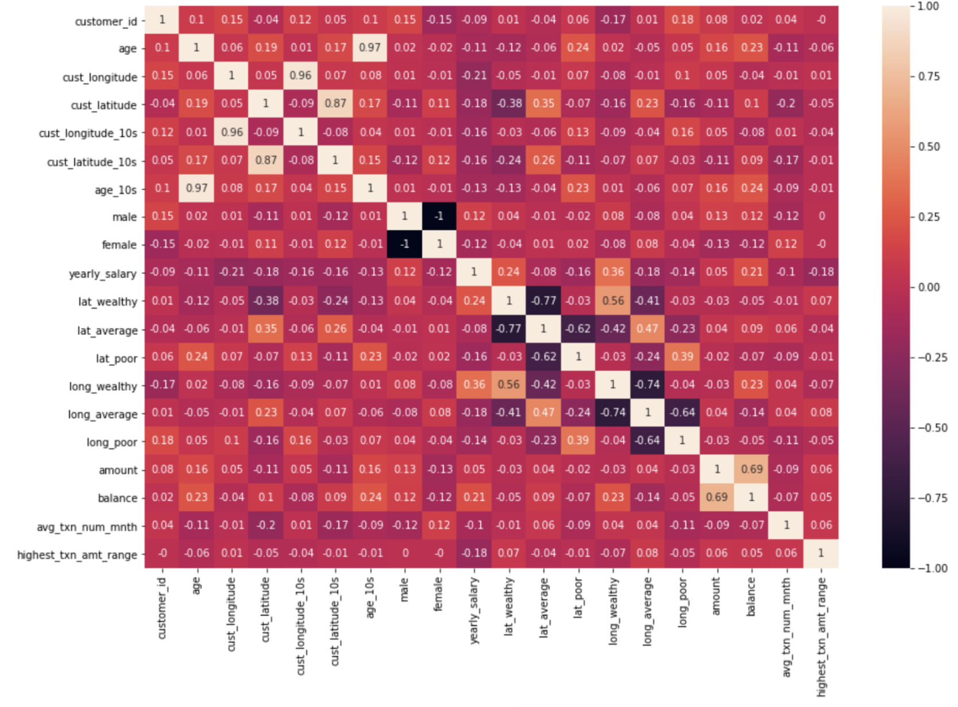
Training data preparation & feature analysis
Available features: [Annual salary = dependent variable]
Age: Age of customer
Age_10s: Age of customer rounded*
Male: Is customer male
Female: Is customer female
Cust_longitude: Longitude of customer
Cust_latitude: Latitude of customer
Cust_longitude_10s: Longitude of customer rounded*
Cust_latitude_10s: Latitude of customer rounded*
Lat_wealthy: Average salary of customers on this latitude is beyond (mean salary + 3 standard deviation)
Lat_average: Average salary of customers on this latitude is between (mean salary +/- 3 standard deviation)
Lat_poor: Average salary of customers on this latitude is beyond (mean salary - 3 standard deviation)
Long_wealthy: Average salary of customers on this longitude is beyond (mean salary + 3 standard deviation)
Long_average: Average salary of customers on this longitude is between (mean salary +/- 3 standard deviation)
Long_poor: Average salary of customers on this longitude is beyond (mean salary - 3 standard deviation)
Amount: Average spent per sales transaction by customer
Balance: Average balance maintained by customer per month, rounded to nearest 10000.
Avg_txn_num_mnth: Average number of transaction done by customer per month, rounded to nearest 50.
Highest_txn_amt_range: Highest sales transaction by customer, rounded to nearest 1000.
*_10s signifies feature round to nearest 10s digit, i.e. 116 = 120, 118=120, 105=100
Feature heatmap before elimination

Slide 2
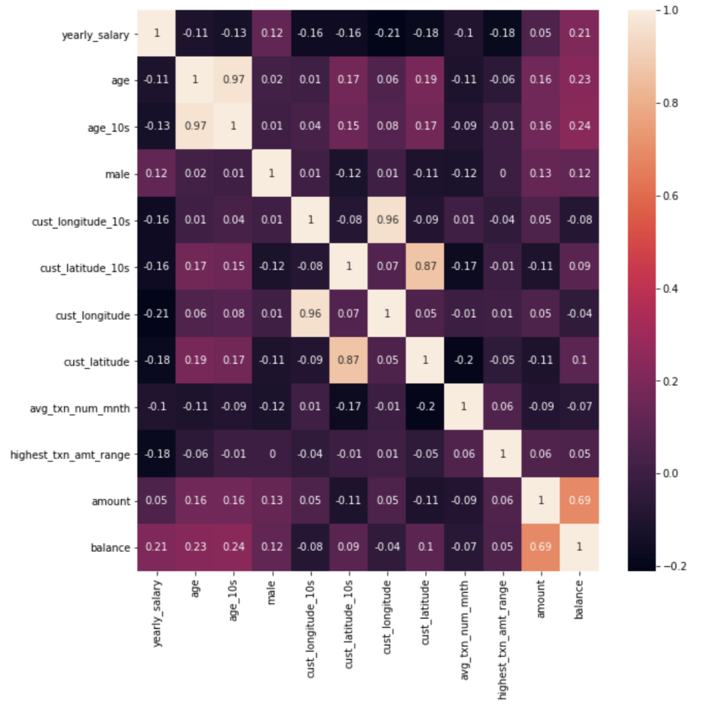
Feature Selection & Engineering
Feature selection criteria:
Eliminate mutually correlated features (i.e. features with mutual correlation > 0.5). Eliminate the one which has lower correlation with dependent variable
Eliminate features with low correlation (generally less than 0.1) with dependent variable.
If 2 features are built on same underlying attribute of customer, select the on with higher correlation with dependent variable.
Heatmap after feature selection
Dealing with data scarcity:
The problem at hand is about predicting customer’s salary. Data-points = 100 unique customers.
The continuous features (median transaction amount, latitude/longitude, average balance, age etc) cannot take all of their granular values in just 100 data points, thus they need to be abstracted so that model can learn and generalize.
Thus continuous features with wide range of values are rounded to nearest 10s, 100s, 1000s, 10000s based to reduce the granularity , improve model learning and generalisation capability.

Slide 3
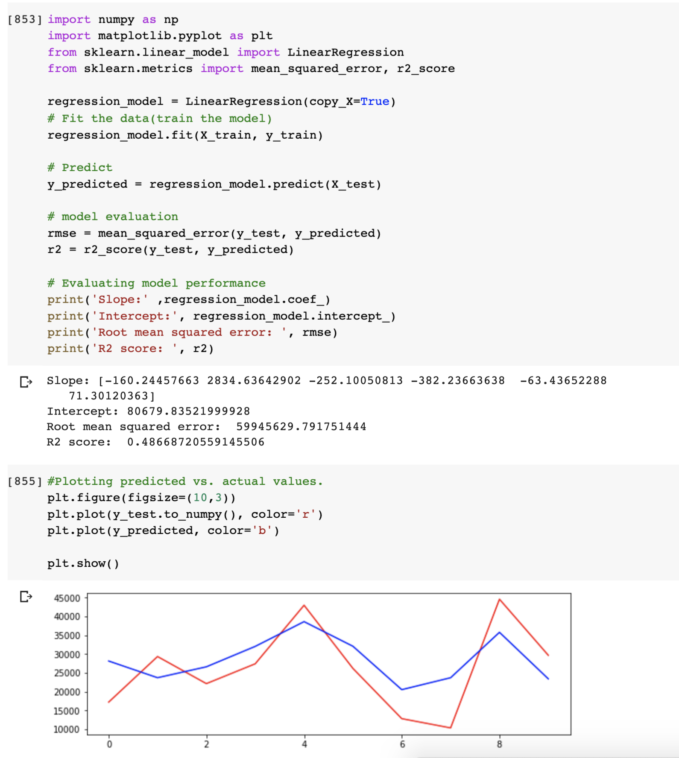
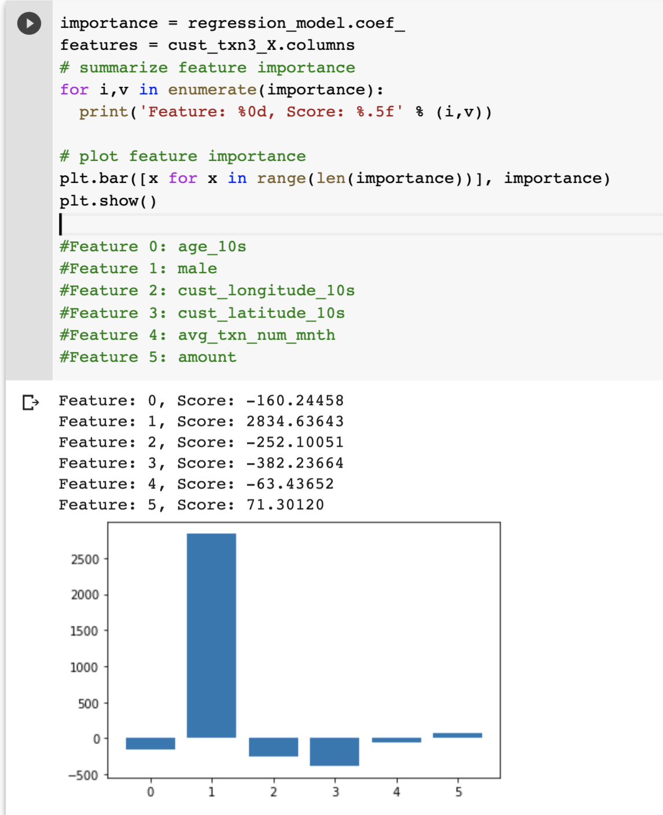
Linear Regression outcomes
Model configuration & performance
Feature Importance

Slide 4
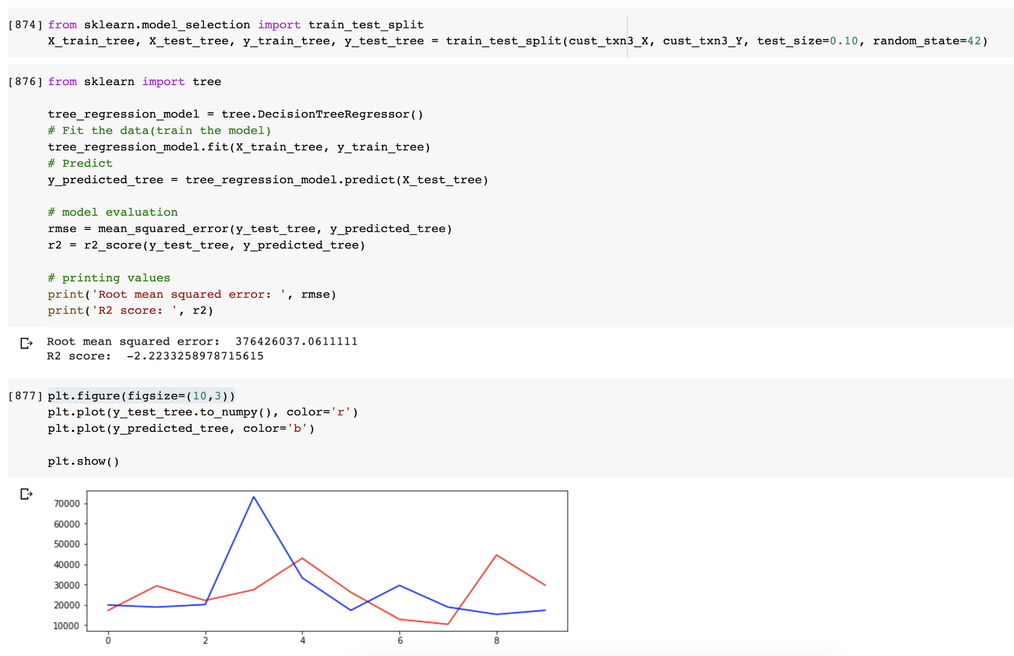
Decision Tree Regression outcomes

Slide 5
Insights from modelling
Linear model’s performance is better than decision tree.
Data scarcity has a significant negative impact on model performance.
The linear model can be used for directional salary prediction but needs more data (for better training & performance) before being used for making any significant business decisions.

